Slide 1
SPRING VALLEY VILLAGE POLICE DEPARTMENT
MONTHLY NEWSLETTER:
JUNE 2024
1025 CAMPBELL ROAD
HOUSTON, TX 77055
PHONE: 713-465-8323
COMMUNITY MATTERS.
WE ARE A TEAM.

Slide 2
INTRODUCTION
Hilshire Village Residents,
Summer is officially upon us. Hopefully, everyone is adjusting to school being out and getting ready for the summer weather. It appears we may have an active hurricane season. In this newsletter you will find some tips to help you prepare.
KEEP IN MIND:
Hurricane season is here. Stock up on your supplies.
Lock your vehicle when it is unoccupied.
Be sure to lock all doors and windows in your home, when you are not on the premises.
Please be cautious while driving through our neighborhoods, as the children will be enjoying more outdoor activities.
As always, we are here if you need us!
Sincerely,
Chief M. Schulze
1025 CAMPBELL ROAD, HOUSTON, TX 77055
PHONE: 713-465-8323 / EMAIL: DISPATCH@SPRINGVALLEYTX.COM

Slide 3
JUNE 2023
DATE | DAY | SPECIAL DAYS FOR THIS MONTH
06-01-2024 | SATURDAY | START OF HURRICANE SEASON
06-16-2024 | SUNDAY | FATHER’S DAY
06-19-2024 | WEDNESDAY | JUNETEENTH
06-20-2024 | THURSDAY | FIRST DAY OF SUMMER
COMMUNITY MATTERS.
WE ARE A TEAM.
1025 CAMPBELL ROAD, HOUSTON, TX 77055 / PHONE: 713-465-8323 / EMAIL: DISPATCH@SPRINGVALLEYTX.COM

Slide 4
HURRICANE PREPAREDNESS:
The hurricane season runs from June 1 to Nov. 30.
Hurricanes are dangerous and can cause major damage from storm surges, wind damage, rip currents, and flooding. They can happen along any U.S. coast or in any territory in the Atlantic or Pacific oceans. Storm surge historically is the leading cause of hurricane-related deaths in the United States.
Please use the following links from the City of Houston for the hurricane checklist and preparedness information.
https://www.houstontx.gov/council/h/disasterprep/METRO-Hurricane-Preparedness.pdf
https://www.houstonoem.org/preparedness-are-you-ready/
Please use the following link for hurricane tracking information.
https://www.nhc.noaa.gov/
COMMUNITY MATTERS.
WE ARE A TEAM.
1025 CAMPBELL ROAD, HOUSTON, TX 77055 / PHONE: 713-465-8323 / EMAIL: DISPATCH@SPRINGVALLEYTX.COM

Slide 5
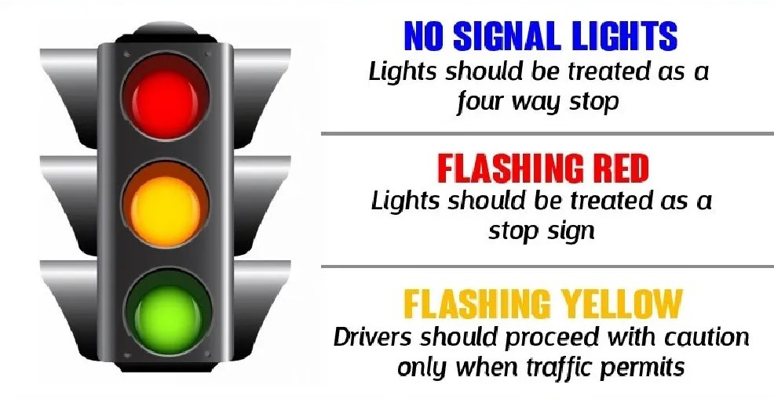
COMMUNITY MATTERS.
WE ARE A TEAM.
1025 CAMPBELL ROAD, HOUSTON, TX 77055
PHONE: 713-465-8323 / EMAIL: DISPATCH@SPRINGVALLEYTX.COM

Slide 6
COMMUNITY MATTERS.
WE ARE A TEAM.
1025 CAMPBELL ROAD, HOUSTON, TX 77055 / PHONE: 713-465-8323 / EMAIL: DISPATCH@SPRINGVALLEYTX.COM

Slide 7
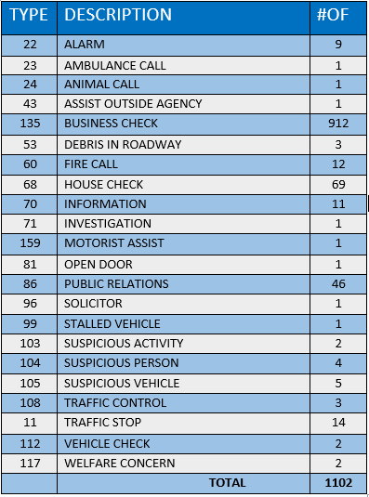
SPRING VALLEY POLICE DEPARTMENT
HILSHIRE VILLAGE
CALLS BY TYPE: 05-01-2024 THRU 05-31-2024
COMMUNITY MATTERS.
WE ARE A TEAM.
1025 CAMPBELL ROAD, HOUSTON, TX 77055
PHONE: 713-465-8323 / EMAIL: DISPATCH@SPRINGVALLEYTX.COM

Slide 8
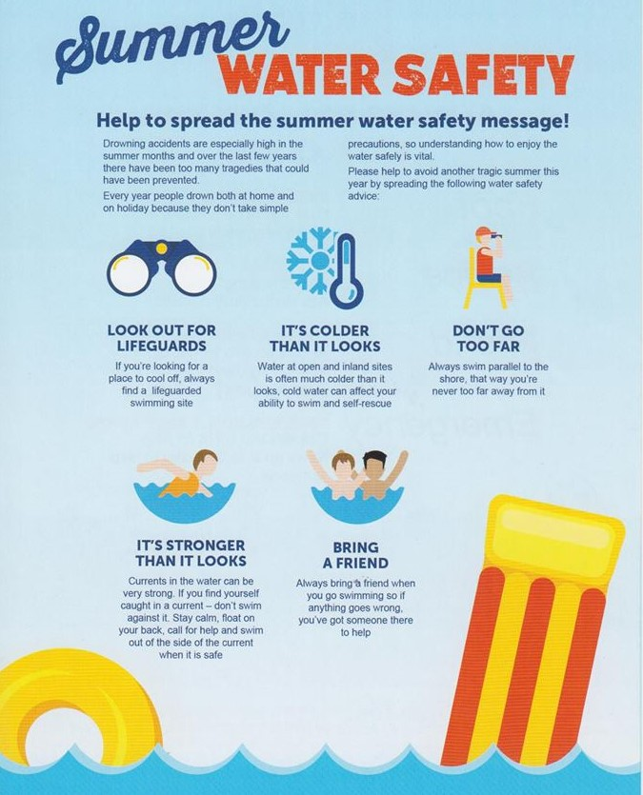
COMMUNITY MATTERS.
WE ARE A TEAM.
1025 CAMPBELL ROAD, HOUSTON, TX 77055
PHONE: 713-465-8323 / EMAIL: DISPATCH@SPRINGVALLEYTX.COM

Slide 9
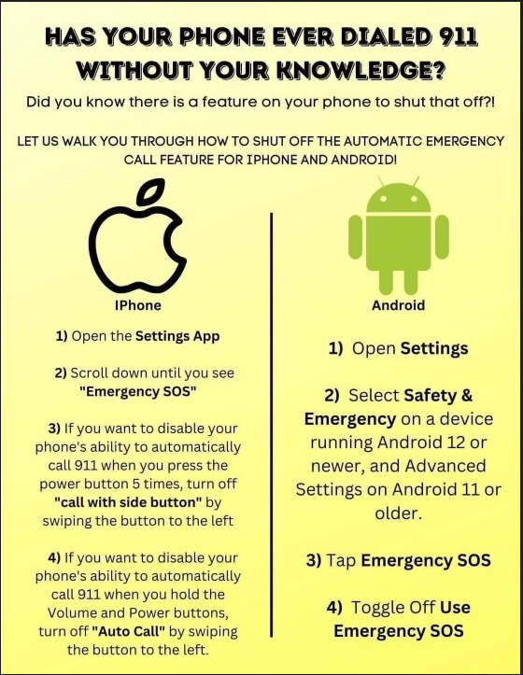
COMMUNITY MATTERS.
WE ARE A TEAM.
1025 CAMPBELL ROAD, HOUSTON, TX 77055
PHONE: 713-465-8323 / EMAIL: DISPATCH@SPRINGVALLEYTX.COM

Slide 10
IMPORTANT NUMBERS AT A GLANCE
EMERGENCY |  | NON - EMERGENCY
911 - FOR ALL EMERGENCY |  | 713-465-8323
988 – NATIONAL SUICIDE & MENTAL HEALTH
SPRING VALLEY VILLAGE |  | VILLAGE FIRE DEPARTMENT
SPRING VALLEY - CITY HALL | 713-465-8308 | VILLAGE FIRE DEPARTMENT |  | 713-465-2323
SPRING VALLEY - PD | 713-465-8323 | VFD - NON-EMERGENCY |  | 713-468-7941
SPRING VALLEY - PD FAX | 713-465-3135
SPRING VALLEY - COURT | 713-465-0333
HILSHIRE VILLAGE
HILSHIRE VILLAGE – CITY HALL | 713-973-1779
COMMUNITY MATTERS.
WE ARE A TEAM.
1025 CAMPBELL ROAD, HOUSTON, TX 77055 / PHONE: 713-465-8323 / EMAIL: DISPATCH@SPRINGVALLEYTX.COM

